Slide 1



Data types and structures in Python

Slide 2







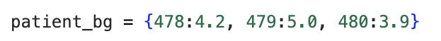
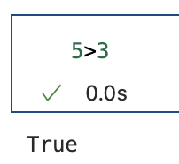
Core Data Types in Python
Numeric
Sequence
Integer
String
Float
List
Tuple
Other
Dictionary
Boolean
Notes:
Some python models or methods only accept certain types of data
Some data structures only accept one data type across variables.
It is easy to confuse one data type with another
Lists:
Ordered, mutable collections
Dictionaries:
Pairs of keys and values
Tuples:
Immutable collections, and unique elements.

Slide 3


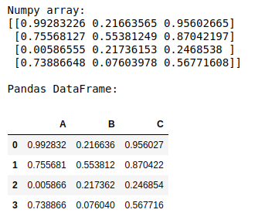

NumPy and Pandas
Arrays
DataFrames
MATLAB equivalent: matrices
MATLAB equivalent: tables
Image: https://www.geeksforgeeks.org/convert-a-numpy-array-to-pandas-dataframe-with-headers/
Notes:
Additional libraries that allow us to structure data more intuitively, and perform operations more efficiently
Data structures affect what operations you can perform a and what python integrations you can use

Slide 4
For the following variables, what are the data types?
1236
"Hello world"
False
"13.5"
2. For the following items, what
structure are they in?
[1, 3, "hello", 4]
{1:"hello", 2:"world"}
[[1,2,3]
[4,5,6]]
Challenge Yourself

Slide 5

For the following variables, what are the data types?
1236: integer
"Hello world": string
False: boolean
"13.5": string
2. For the following items, what
structure are they in?
[1, 3, "hello", 4]: list
{1:"hello", 2:"world"}: dictionary
[[1,2,3]
[4,5,6]]: array

